Slide 1



Data Analysis - Trends of Sports Market in Istanbul and Predicting the Next Trend
Created By: resat Caner Bas
Date: 31.07.2020

Slide 2
Content
Introduction
Exploring the Data
Conclusion

Slide 3
Introduction

Slide 4
Introduction
The problem
The Interest
Data Collection
As a result, many disciplines of sports become more and more popular. However, not all of them become more popular and almost none of them can keep itself as the most preferred one.
In this report, you will find an analysis of sports market in Istanbul, more specifically, Kadikoy and Besiktas Towns and a prediction for an upcoming trend if possible.
The results of this report may give a deeper insight to the investors planning to find a business targeting the sports market around the Istanbul and in other regions.
The neighborhoods of Kadikoy and Besiktas are used. The data of this collected from Turkish Postal Office Database
Longitude and Latitude data related to the neighborhoods are collected via Google Geocoding API
Venue details are collected via Foursquare Places API
Venue details are broken into two databases and recorded as CSV

Slide 5
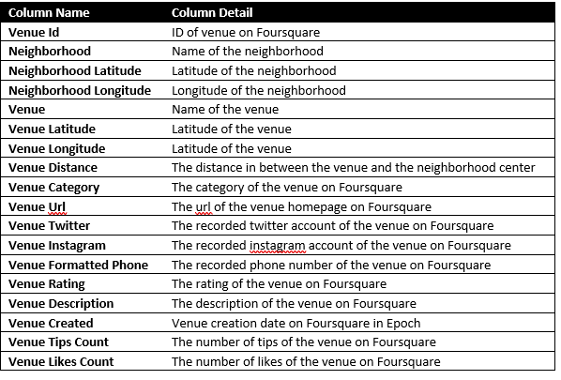
Database Details

Slide 6
Exploring THE DATA

Slide 7
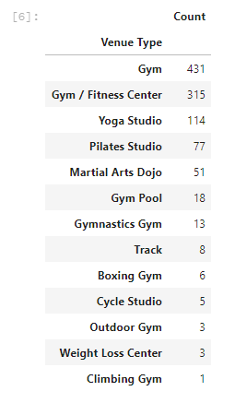
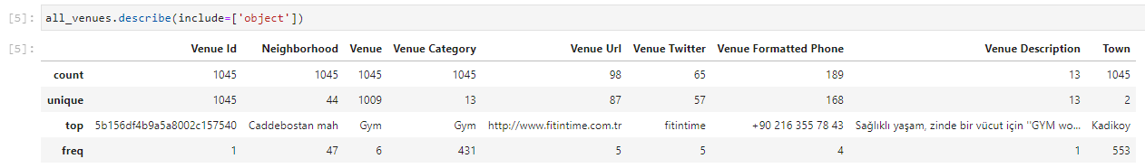
Exploring the Data
According to the description :
Kadikoy is the town with most venues
Caddebostan is the neighborhood with most venues
Gym is the most dominant category (41%)

Slide 8
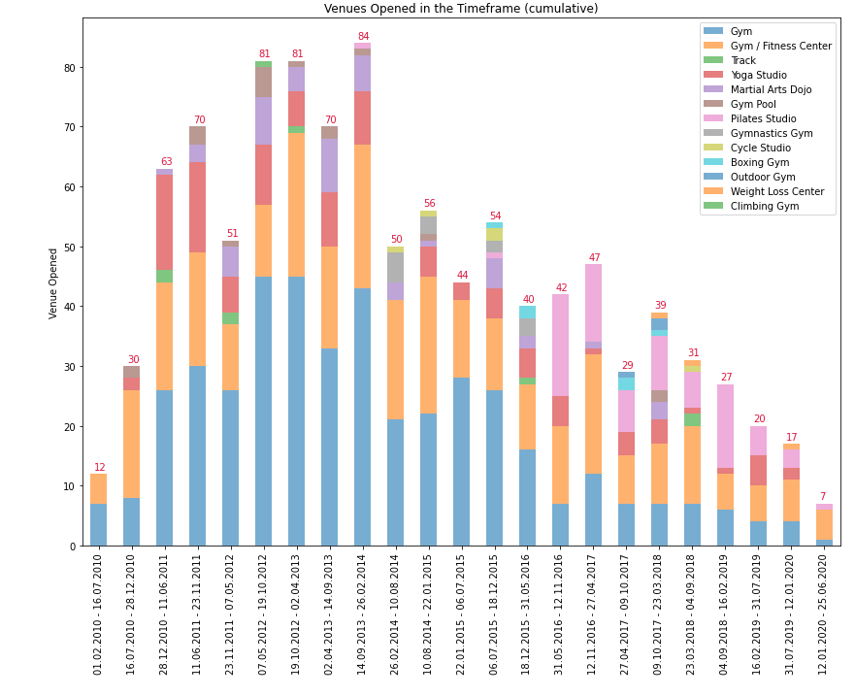
Exploring the Data
Venues opened in the timeframe in all neighborhoods over time

Slide 9
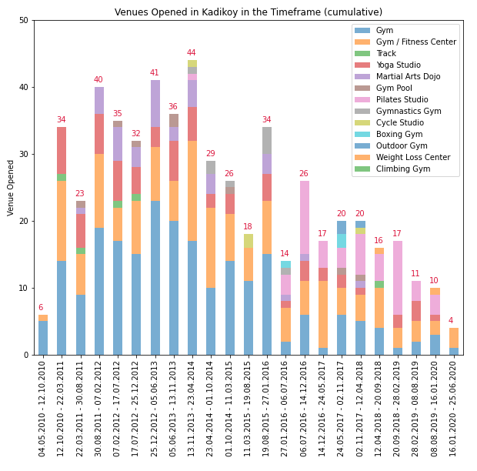
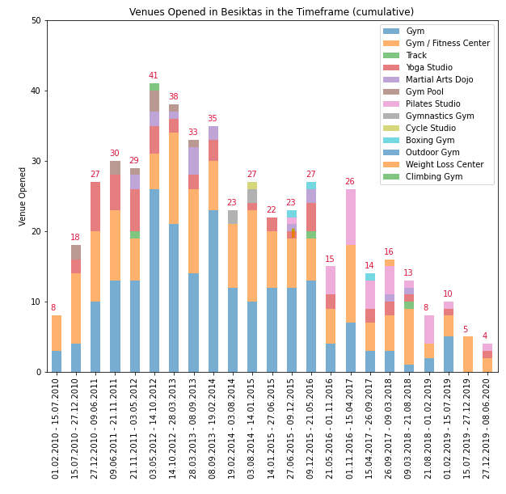
Exploring the Data

Slide 10
Exploring the Data
Venue distribution over time
Venue rating distribution over time

Slide 11
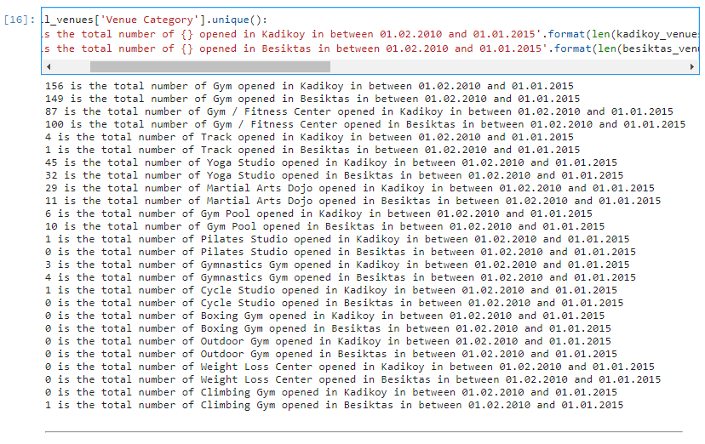
Exploring the Data
On the halfway, the numbers look identical, however Kadikoy is leading for Gym, Track, Track Yoga Studio, Martial Arts Dojo and Pilates Studio categories whereas Besiktas is leading the Gym / Fitness Center, Gymnastic Gym and Gym Pool categories

Slide 12
Two content layout with table
First bullet point here
Second bullet point here
Third bullet point here
Class | Group 1 | Group 2
Class 1 | 82 | 95
Class 2 | 76 | 88
Class 3 | 84 | 90

Slide 13
Conclusion

Slide 14
Conclusion
At first glance, Gyms and Gym fitness center seems to dominate all the regions, however it can’t be neglected the Yoga Studio, Pilates Studio and Martial Art Dojo venues have strong trends.
According to the trends, Kadıköy seems one step ahead for those popular categories. It could be a good advice to follow trends in Kadıköy and apply them in other regions to catch the trend.
2 different ML methods are applied to reach the best results to predict the most profitable investment out of the dataset.

Slide 15
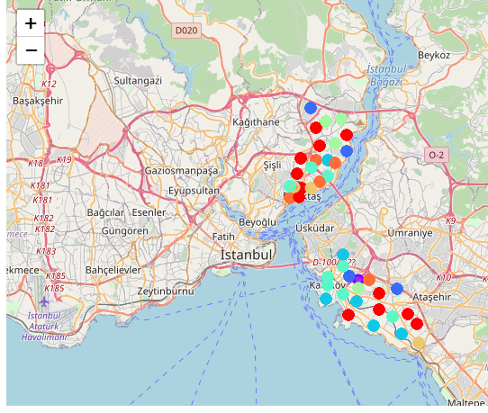
Clustering
Clustering gives a great overview to see where the deviations for categories are. For example, in cluster 6, Yoga Studio is the 2nd most common venue, and it might be good to consider an investment on Turkali Mah. neighborhood. The frequency of the Venue Category is the base of the model.

Slide 16
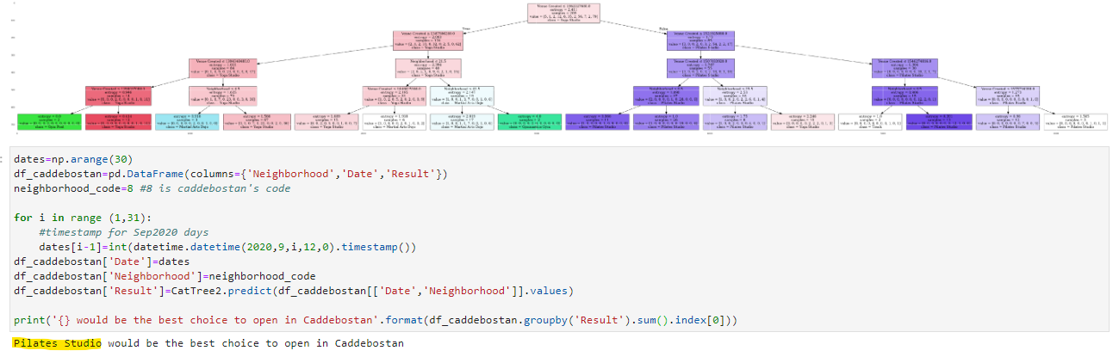
Exploring the Data
Decision Tree is created based on following features:
Venue Created : Date
Neighborhood : Location
Due to the domination of Gym and Gym Fitness Center categories, the accuracy of the Decision Tree is affected. It tends to locate the result in between those two categories.
However, it is acceptable with the dataset except those categories. According to the result of the tree, it could be the best to invest on a Pilates Studio in Kadikoy - Caddebostan, in September. Similar predictions can be made using the model.

